Slide 1
Python Programming
Functions
Dr. Raj Gaurang Tiwari
Department of Computer Science and Engineering
Chitkara University, Punjab

Slide 2
Contents
Introduction
Function Definition
Argument Passing
Types of Arguments

Slide 3
Introduction
A function is a block of organized, reusable code that is used to perform a single, related action. Functions provides better modularity for your application and a high degree of code reusing.

Slide 4
Introduction
A small set of instructions/logic that needs to be executed multiple times
Flow of control jumps to another section or file
A function first needs to be defined
Once defined, function can be called multiple times
Functions can be passed arguments
Functions can optionally return a value
Built-in functions: input(), print(), len()
Makes code reusable and modular, no copy/paste

Slide 5
Function Definition
Definition: consists of name and body
def keyword followed by a <function_name>
followed by optional parameters in parentheses
followed by a colon
followed by indented body
body may contain a return statement

Slide 6
Functions
● Return statement is optional
● Can appear anywhere inside the function
● return stops function execution and sends the control and return value back to the caller
● if return is omitted, a value of None is returned back to the caller

Slide 7
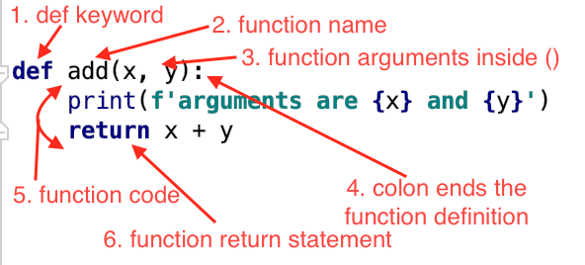
Function Definition

Slide 8
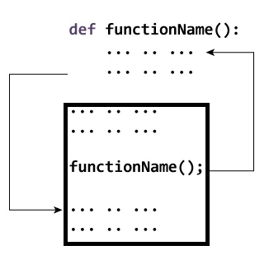
Control Flow

Slide 9
Example
def my_function(): print("Hello from a function")
my_function()
def sum(a, b):
return a + b
sum(2,3)

Slide 10
Passing a List as an Argument
def myfunction(food): for x in food: print(x) fruits = ["apple", "banana", "cherry"] myfunction(fruits)

Slide 11
Function - Argument matching
Arguments from a function call are matched to parameters in function definition from left to right
The number of arguments passed should be same as the number of parameters defined in the function

Slide 12
Function Arguments:
A function by using the following types of formal arguments::
Required arguments
Keyword arguments
Default arguments
Variable-length arguments

Slide 13
Required arguments
Required arguments are the arguments passed to a function in correct positional order.
def printme( str ): "This prints a passed string"
print str;
printme();
This would produce following result:
TypeError: printme() takes exactly 1 argument (0 given)

Slide 14
Keyword arguments
Keyword arguments are related to the function calls. When you use keyword arguments in a function call, the caller identifies the arguments by the parameter name.
This allows you to skip arguments or place them out of order because the Python interpreter is able to use the keywords provided to match the values with parameters.

Slide 15
Example
Following example gives more clear picture. Note, here order of the parameter does not matter:
def printinfo( name, age ): "Test function"
print "Name: ", name;
print "Age ", age;
printinfo( age=50, name="miki" );
This would produce following result:
Name: miki Age 50

Slide 16
Default arguments
A default argument is an argument that assumes a default value if a value is not provided in the function call for that argument.
Following example gives idea on default arguments, it would print default age if it is not passed:
def printinfo( name, age = 35 ): “Test function"
print "Name: ", name;
print "Age ", age;
printinfo( age=50, name="miki" );
printinfo( name="miki" );
This would produce following result:
Name: miki Age 50
Name: miki Age 35

Slide 17
Variable-length arguments
You may need to process a function for more arguments than you specified while defining the function. These arguments are called variable-length arguments and are not named in the function definition, unlike required and default arguments.
The general syntax for a function with non-keyword variable arguments is this:
def functionname([formal_args,] *var_args_tuple ):
function body

Slide 18
Example
An asterisk (*) is placed before the variable name that will hold the values of all nonkeyword variable arguments. This tuple remains empty if no additional arguments are specified during the function call. For example:
def printinfo( arg1, *vartuple ):
print "Output is: "
print arg1
for var in vartuple:
print var
printinfo( 10 )
printinfo( 70, 60, 50 )
This would produce following result:
Output is:
10
Output is:
70
60
50

Slide 19
Example
def greet(*names):
for i in names:
print(“Hello” + i)
greet('Steve', 'Bill', 'Yash')
greet('Steve', 'Bill', 'Yash', 'Kapil', 'John', 'Amir')

Slide 20
Scope of Variables
All variables in a program may not be accessible at all locations in that program. This depends on where you have declared a variable.
The scope of a variable determines the portion of the program where you can access a particular identifier. There are two basic scopes of variables in Python −
Global variables
Local variables

Slide 21
Example
total = 0; # This is global variable.
# Function definition is here
def sum( arg1, arg2 ):
total = arg1 + arg2; # Here total is local variable.
print "Inside the function local total : ", total
return total;
# Now you can call sum function
sum( 10, 20 )
print "Outside the function global total : ", total

Slide 22
Global vs. Local variables
Variables that are defined inside a function body have a local scope, and those defined outside have a global scope.
This means that local variables can be accessed only inside the function in which they are declared, whereas global variables can be accessed throughout the program body by all functions. When you call a function, the variables declared inside it are brought into scope.

Slide 23
Summery
Introduction
Definition
Types of Arguments
Examples

Slide 24
Thank You !

